Slide 1
Why Accessibility is Important
IMAGE
Accessibility, applicable laws, and you
Michelle Pinsky, UX Designer
August 27, 2024

Slide 2
Agenda
Introduction What this seminar covers Why this is the most important seminar so far What is Accessibility? A definition How accessibility benefits users How accessibility benefits you Rising Trend in Lawsuits Yes, this is a thing! How it happens Am I safe?
Applicable Laws & Guidelines
Americans with Disabilities Act (ADA)
Section 508
Enterprise Architecture Standard
WCAG 2.1
Q&A​
Next Seminar Date & Topic
vita.virginia.gov

Slide 3
Introduction

Slide 4
What this seminar covers
(Or what we're hoping to cover in this timeblock)

Slide 5
Why this is the most important seminar so far
(No, really!)

Slide 6
What is accessibility?
So let's get started...

Slide 7
A definition
Accessibility is the practice ensuring there are as few barriers as possible that prevent interaction with, or access to, technology, regardless of disability, technological literacy, or socioeconomic factors.

Slide 8
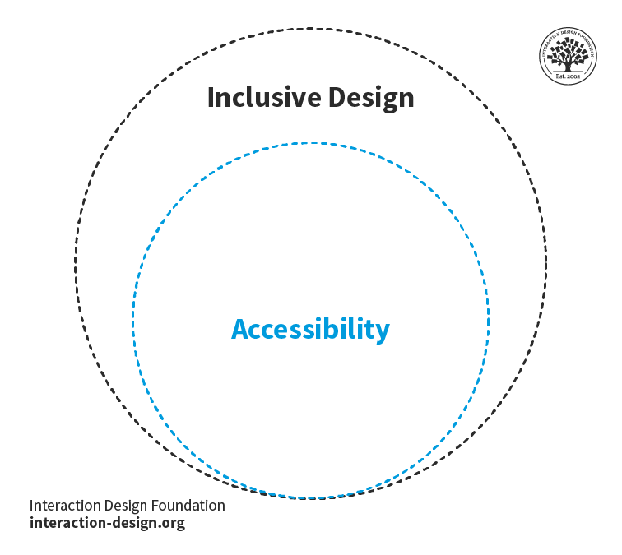
Inclusive design vs. accessibility

Slide 9
How accessibility benefits users
Accessibility helps users with disabilities by making technology available to assistive devices, such as screen readers, screen magnifiers, and braille output devices. Accessibility helps users with slower internet connections by limiting the information on the page and by degrading the content gracefully through front-end code. Accessibility helps users who are elderly by allowing the content to be enlarged natively within a browser. Accessibility helps who use alternative methods of input, either through devices for those with mobility impairments, or keyboard navigation. Mostly, accessibility helps all users, no matter their background!

Slide 10
How accessibility benefits you
Accessibility saves money if built with accessibility in mind first. If it's built right the first time, it is less expensive to fix it. Direct remediation is less expensive than adding a widget. Building it right the first time is even cheaper.
 | Widget (such as an overlay) | Direct remediation
Minimum | $3,348 | $5,418
Maximum | $43,080 | $58,464
Median | $12,444 | $8,851
Average | $16,342 | $14,034
Source: Afixit.com. Based on annual cost from 13 accessibility overlay widgets of publicly displayed pricing compared to Afixit's direct remediation services.

Slide 11
How accessibility benefits you
Accessibility assists our citizens and helps us in providing our civic duty in making web technology available to all citizens, regardless of how, when, and where they access our information. Knowledge is power! Accessibility protects our agencies from expensive lawsuits and negative public relations by abiding by applicable state and federal regulations.
Finally, accessibility is just the correct and empathetic thing to do!

Slide 12
The Rising Trend of Accessibility Lawsuits

Slide 13
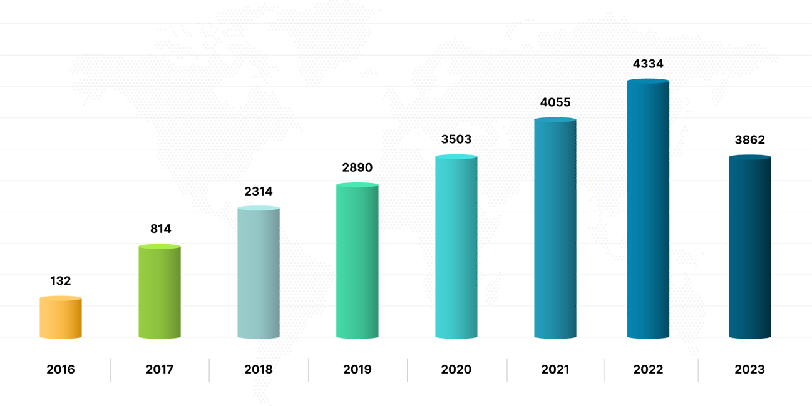
Lawsuits are on the rise
Number of ADA Title II lawsuits from 2016-2023
Source: ecomback.com. The decrease does not equal a lack of digital accessibility lawsuits, but rather, ADA Title II filings as litigation has begun shifting to a state level.

Slide 14
How this happens
"The Law Firm Hitting Businesses With Thousands of Disability Suits" Entrepreneurs face allegations that their websites aren't accessible to visually impaired people. - The Wall Street Journal "Maine businesses sued for their websites not being 'ADA accessible', paying $9,000-$23,000 in damages" Under the law, businesses open to the public must provide equal access to their goods and services. - WGME
"Lawsuits over disabled Americans' access to websites have surged" They aren't making sites easier to use, but some people are profiting. - The Economist "Website Accessibility Lawsuits Rising Exponentially in 2023 According to Latest Data" Lawsuits against website owners alleged to have breached the Americans with Disabilities Act have increased rapidly during the first half of 2023 across virtually every metric conceivable. - Forbes

Slide 15
Am I safe?
In order for your agency to be protected, your application must follow the ADA, Section 508, and the Enterprise Architecture Standard.
By following the WCAG 2.1 AA standard, you stand the best chance of being protected!

Slide 16
Applicable Laws & Standards
(Let's go over them one by one)

Slide 17
ADA Title II

Slide 18
ADA 101
The Americans with Disabilities Act (ADA) is a broad civil rights law that prohibits discrimination against people with disabilities in services offering "public accommodation." Title II specifically calls out digital accessibility for governments by stating: "Title II of the ADA prohibits discrimination against people with disabilities in all services, programs, and activities of state and local governments. State and local governments must take steps to ensure that their communications with people with disabilities are as effective as their communications with others. For these reasons, the Department has consistently taken the position that the ADA’s requirements apply to all the services, programs, or activities of state and local governments, including those offered on the web." Title II now mandates that state and local governments make their web content and mobile applications accessible to people with disabilities based on WCAG 2.1 AA standards by April 24, 2026. It is enforced by consumers (users) filing formal complaints. You can learn more by visiting ADA.gov. (It is strongly encouraged state employees working in digital content give this page a read.)
Notes:
Americans with Disabilities Act of 1990 has roots in Section 504 of the Rehabilitation Act of 1973, which guarantees certain rights to people with disabilities. It was one of the first U.S. federal civil rights laws offering protection for people with disabilities.

Slide 19
How long do I have to comply?
State and local governments have within 2 or 3 years of when the rule was published on April 24, 2024 depending on their population size. School districts are not special district governments. City school districts would use their population size of their city to know when to comply. County districts would use their county population size, etc. If the school district is an independent one, it would use the population estimate in the most recent Small Area Income and Poverty Estimates. Universities and colleges are NOT EXEMPT and would fall under state and local government population size levels to know when to comply.
State & local government pop. size | Compliance date
0 to 49,999 persons | April 26, 2027
Special district governments | April 26, 2027
50,000 or more persons | April 24, 2026

Slide 20
The big Title II update exemptions
Archived web content must meet ALL these criteria to be considered exempt: The content was created before the date the state or local government must comply with this rule, or reproduces paper documents or the contents of other physical media that were created before the government must comply with this rule, AND The content is kept only for reference, research, or recordkeeping, AND The content is kept in a special area for archived content, AND The content has not been changed since it was archived.

Slide 21
The big Title II update exemptions
Documents that meet both of the following points usually do not need to meet WCAG 2.1, Level AA, except in some situations: The documents are word processing, presentation, PDF, or spreadsheet files; AND They were available on the state or local government’s website or mobile app before the date the state or local government must comply with this rule. Documents that are currently being used to apply for, access, or participate in a state or local government’s services, programs, or activities do not fall under the exception even if the documents were posted before the date the government must comply with the rule.

Slide 22
The big Title II update exemptions
Content posted by a third party where the third party is not posting due to contractual, licensing, or other arrangements with a public entity. Example: A message that a member of the public posts on a town’s online message board would probably fall under the exception. Content posted or created by state or local government's contractor or vendor IS NOT EXEMPT. Example: If a state or local government uses a company to design, manage, or update its website, the content the company posts for the government would not fall under the exception, and it would usually need to meet WCAG 2.1, Level AA.

Slide 23
The big Title II update exemptions
Individualized documents that are password-protected must meet ALL of the following criteria to be considered exempt: The documents are word processing, presentation, PDF, or spreadsheet files, AND The documents are about a specific person, property, or account, AND The documents are password-protected or otherwise secured. Example: A PDF version of a water bill for a person’s home that is available in that person’s secure account on a city’s website would probably fall under the exception. However, the exception does not apply to the city’s website itself. Example: If a person’s water bill is made available for them to view on a password-protected website as HTML content, the exception would not apply because the content is not in one of the listed document formats, and the content would usually need to meet WCAG 2.1, Level AA. Example: If the water company posts a PDF document on a password-protected website about an upcoming rate increase for all customers, the exception would not apply, and the document would usually need to meet WCAG 2.1, Level AA, because the document is not about one customer’s account.

Slide 24
Section 508

Slide 25
Section 508 of the Rehabilitation Act of 1973
Section 508 of the Rehabilitation Act is a procurement law that: Requires the US government to take accessibility into account when procuring IT (hardware, software, websites, etc.). WCAG 2.0 levels A and AA are required to be incorporated into this IT. Section 508 specifically states: "The law 29 U.S.C § 794d applies to all federal agencies when they develop, procure, maintain, or use electronic and information technology. Under Section 508, agencies must give disabled employees and members of the public access to information comparable to the access available to others." It applies to US federal government entities only, but to sell to the federal government, third-party vendors have to offer accessible products and services. It is enforced by consumers (users) filing formal complaints. You can learn more by visiting section508.gov.

Slide 26
Enterprise Architecture Standard

Slide 27
Enterprise Architecture Standard (EAS)
The Enterprise Architecture Standard is VITA's own standard for executive agencies to follow when procuring, maintaining, and building websites and applications for the state of Virginia and their related services. It has its own accessibility section that is IN ADDITION TO, but does not replace, the ADA Title II requirements. If you are following ADA Title II requirements (WCAG 2.1 AA), you are following the EAS regulations as they are based off of Title II. The most recent standard can be found here. Developer.virginia.gov also has a quick start and in-depth plain language guide for those who want an easier breakdown. It is always being looked at for improvements! Please reach out to the Web Modernization team at VITA if you have suggestions!

Slide 28
WCAG 2.1 AA

Slide 29
WCAG 2.1 AA
The Web Content Accessibility Guidelines (WCAG) are an international standard that explain how to make web content more accessible to people with disabilities. It contains WCAG 2.0, 2.1, and 2.2. Guidelines are given in levels A, AA, and AAA for each standard version. Federal and state rules and regulations reference either WCAG 2.0 AA (Section 508) and WCAG 2.1 AA (ADA). We at VITA require agencies to follow WCAG 2.1 AA. All standards are built off each other. For example, if you have followed WCAG 2.1, you have also fulfilled WCAG 2.0. This is not an easy document to read, but it is recommended all web developers and content authors look at the standard we follow here. Please use Siteimprove to do your initial scan for accessibility, and then perform a manual test of your site to catch the remaining accessibility issues for remediation. Always remediate with a human before launch!

Slide 30
Questions?

